Slide 1
Coronary Heart Disease (CHD) Prediction
Jackson Holmes, Josh Hee, Sean Fu, Aneesh Harwalkar

Slide 2
Table of contents
01
02
03
04
Introduction
Description and Transformation of Data
Methodology
Results and Conclusions

Slide 3
01
Introduction

Slide 4
Project Background
Goal
Audience
Extract valuable insights in the realm of healthcare from a public dataset. Create predictive models using machine learning
Healthcare researchers and professionals, data scientists and analysts, public health officials
Purpose
Context
Explore trends within healthcare data and variable correlations with medical conditions.
About 695,000 people in the United States died from heart disease in 2021—that's 1 in every 5 deaths

Slide 5
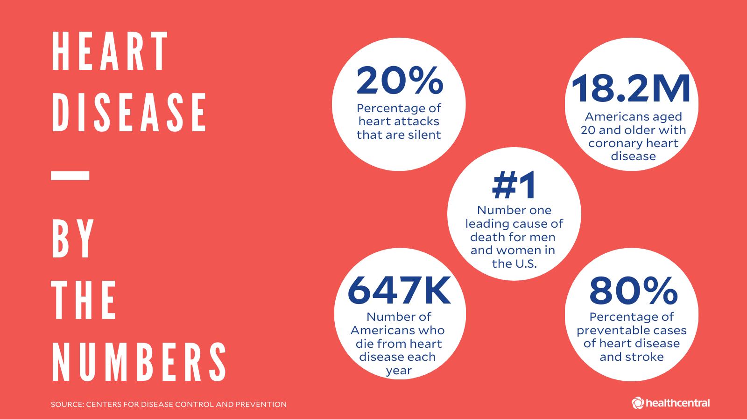

Slide 6
02
Description and Transformation of Data

Slide 7
Description and Transformation of Data
Source
Attributes
Framingham Heart Study Dataset from Kaggle.
Dataset
4,240 records of the residents of Framingham Massachusetts. The dataset includes 15 attributes including, gender, diabetes, current smoker, etc.
Processing
Cleaned the dataset and removed the education column. Split the dataset into male and female dataframes and training dataframes for the MLP classifier.

Slide 8
Feature Table
Feature | male | age | currentSmoker | cigsPerDay | BP Meds | prevalent Stroke | prevalent Hyp | diabetes | tot Chol | sys BP | dia BP | BMI | heart Rate | glucose | Ten Year CHD
dytpe | int | int | int | float | float | int | int | int | float | float | float | float | float | float | int
Rationale | Male vs. female bodies may impact CHD | Higher age, higher risk of CHD | If is smoker, more at risk of CHD | More cigs, more risk of CHD | If on BP Meds, is at higher risk of CHD | If has stroke history,is at more risk of CHD | Hyper-tensive correlates to CHD | If diabetic, higher risk of CHD | High chol levels mean more risk of CHD | High systolic BP impacts CHD | High diastolic BP impacts CHD | Greater BMI means more risk of CHD | Fast heart rate may mean risk of CHD | Higher glucose levels, higher chance of CHD | Predict variable, assess patient risk of CHD

Slide 9
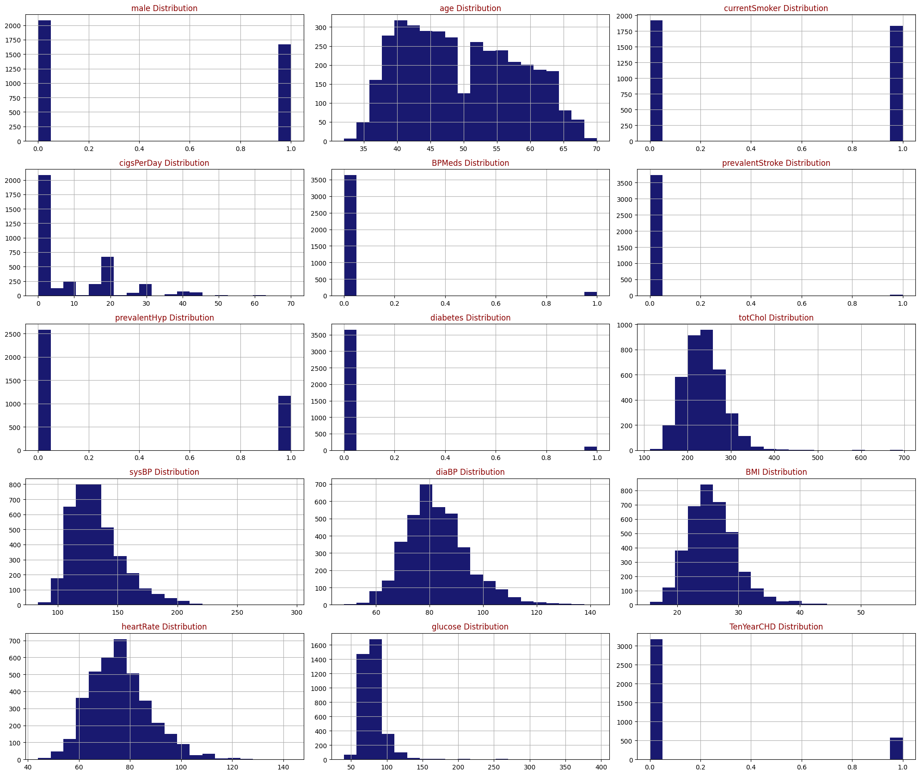
Dataset Exploration

Slide 10
03
Methodology

Slide 11
Description and Transformation of Data
Logistic Regression
MLP Classifier
The logistic regression model serves to estimate the relationship between having heart disease and the attributes in the table. The logistic regression model can also be used to predict if someone is at risk or has heart disease.
A Multi-Layer Perceptron (MLP) classifier is a type of artificial neural network designed for supervised learning tasks, particularly in the field of machine learning and pattern recognition.

Slide 12
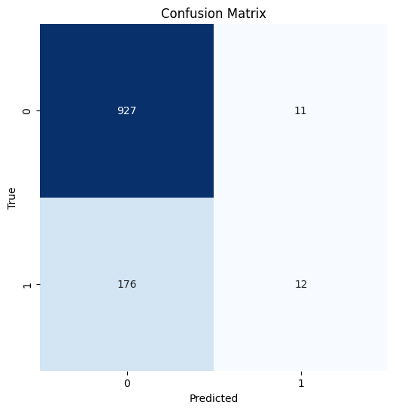
Logistic Regression Model
Accuracy: 0.8308921438082557
Precision: 0.5714285714285714
Recall: 0.06201550387596899
F1-score: 0.11188811188811189
8:2 Train to test ratio

Slide 13

Logistic Regression Model Improved
Accuracy: 0.8748335552596538
Precision: 0.4166666666666667
Recall: 0.05434782608695652
F1-score: 0.09615384615384615
7:3 Train to test ratio

Slide 14
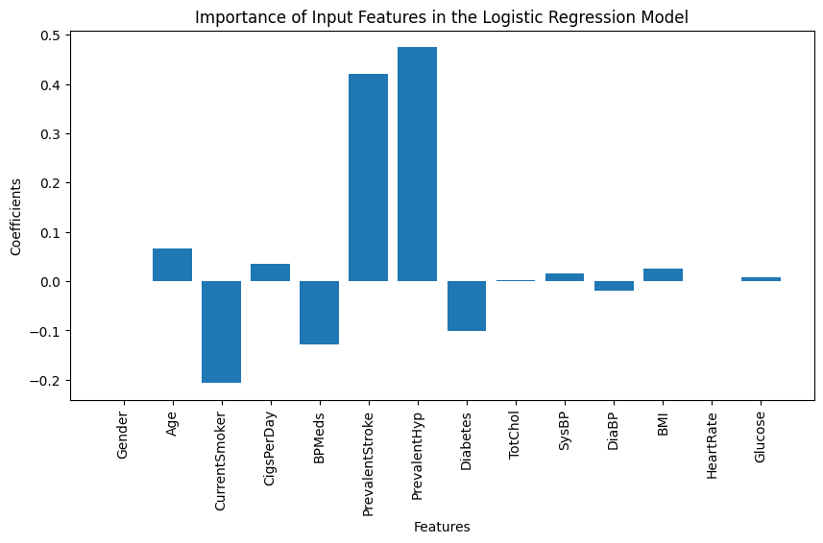
Importance of Features in Logistic Regression Model
Feature Importance
6 PrevalentHyp 0.474570
5 PrevalentStroke 0.420086
1 Age 0.065872
3 CigsPerDay 0.035204
11 BMI 0.025738
9 SysBP 0.015427
13 Glucose 0.008722
8 TotChol 0.001347
12 HeartRate 0.001034
0 Gender 0.000000
10 DiaBP -0.018557
7 Diabetes -0.100283
4 BPMeds -0.127736
2 CurrentSmoker -0.206525

Slide 15
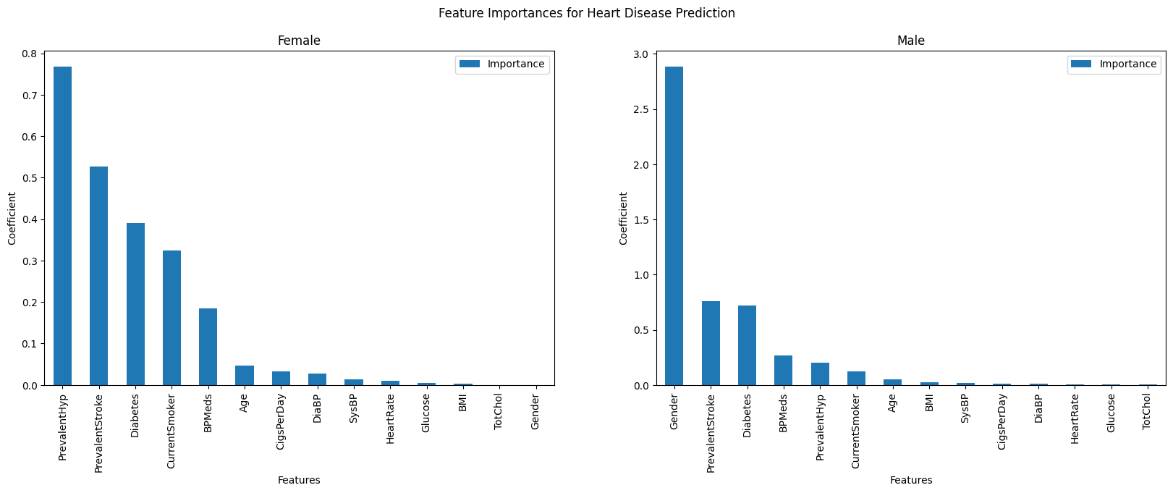
Importance of Features on Gender
Accuracy: 0.894484412470024
Precision: 0.75
Recall: 0.06521739130434782
F1-score: 0.12
Accuracy: 0.8143712574850299
Precision: 0.6666666666666666
Recall: 0.09230769230769231
F1-score: 0.16216216216216217

Slide 16
MLP Classifier
Features/Columns
Takeaways
All features were used to train the MLP Classifier (Gender, Age, CurrentSmoker, CigsPerDay, BPMeds, PrevalentStroke, PrevalentHyp, Diabetes, TotChol, SysBP, DiaBP, BMI, HeartRate, Glucose)
Both scores indicate relatively high accuracy.
The Logistic Classifier has a higher accuracy compared to the MLP Classifier
Based on accuracy alone, the Logistic Classifier might be preferred over the MLP Classifier for this particular task or dataset.
However, other factors have to be considered. For example, the importance of these features.
Accuracy
Logistic Classifier = 0.8748335552596538
MLP Classifier = 0.8475073313782991

Slide 17
04
Results and Conclusions

Slide 18
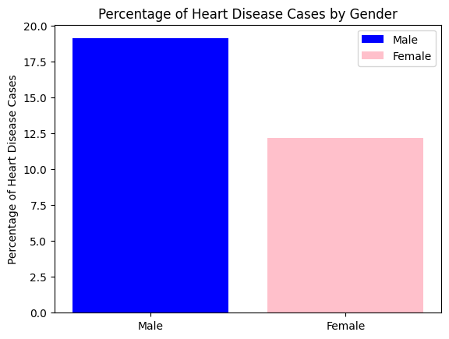
Percentage of Heart Disease Cases by Gender

Slide 19
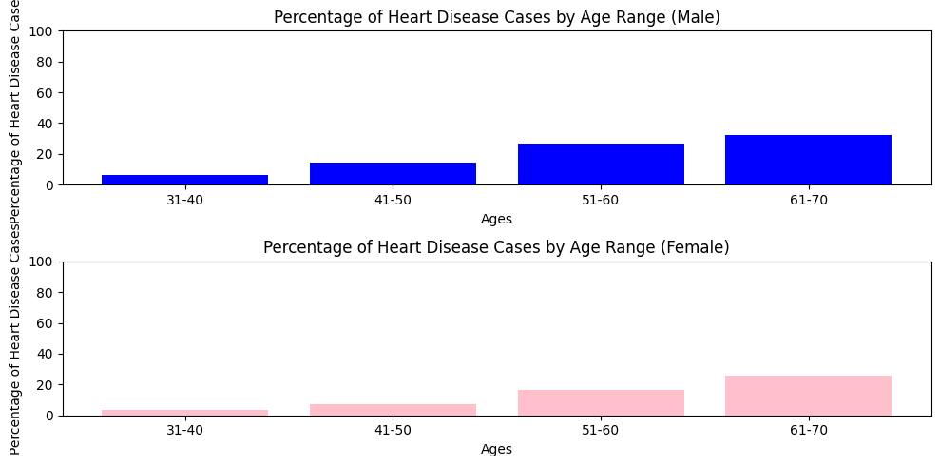
Percentage of Heart Disease Cases by Age Range

Slide 20
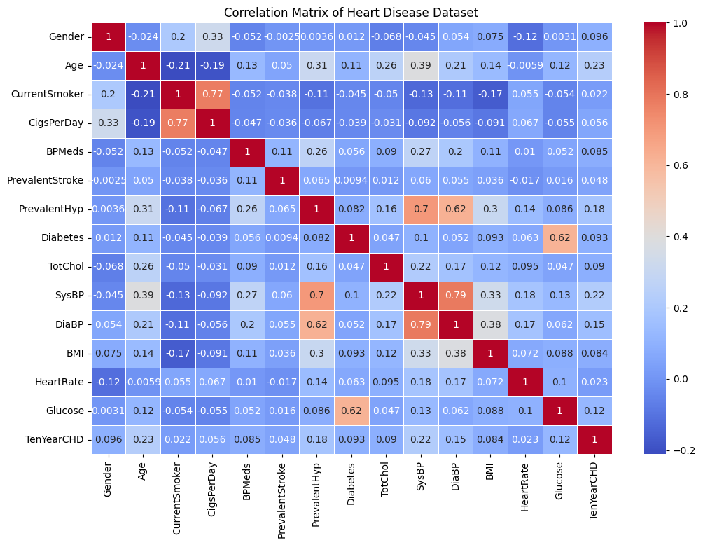
Heart Disease Correlation Matrix

Slide 21
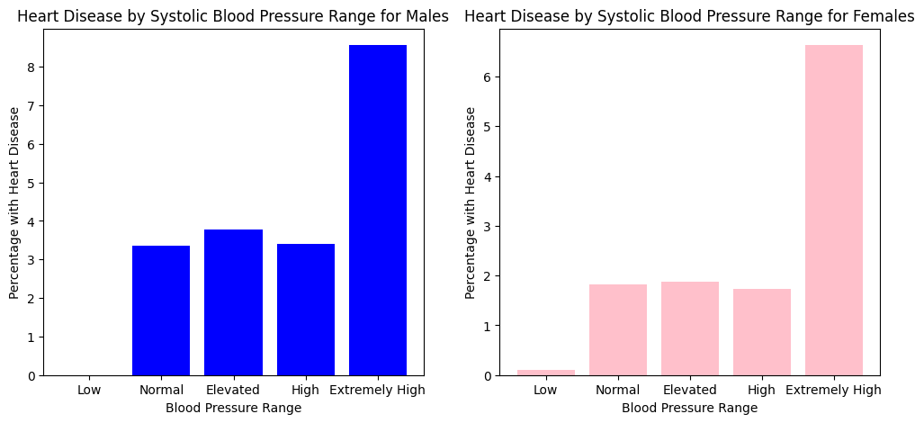
Percentage of Heart Disease Cases by Systolic Blood Pressure

Slide 22
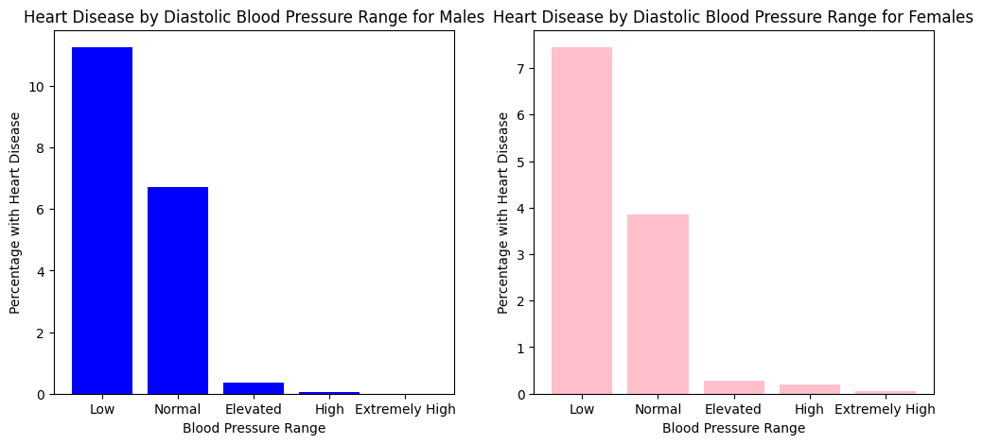
Percentage of Heart Disease Cases by Diastolic Blood Pressure

Slide 23
Conclusions
Takeaways
Bias
Individuals can assess their own risk of CHD based on their health data
This can help identify high-risk groups based on demographics and behavior
Healthcare providers can understand what types of health data are more more to CHD (extremely high systolic BP, low diastolic BP, age range of 61-70)
Underrepresentation of certain demographic groups (may not generalize well to different populations)
Lack of some factors that can lead to CHD, only used what was in the original dataset
Certain features in data set may be influenced by genetic code/family history
400 more females are present than males in the data set

